Slide 1

Linköping university
Instead of LiU's profile colors, you can use an image as a background on the home page. Here are some examples that you can use or customize.

Slide 2
1. Text slides
Use the section slide if you need to explain the transition to a new section in long presentations.
Use the same background colour for all – or use different colours to group related sections, and to set unrelated sections apart.

Slide 3
Use a black or a white background
Slides are available with a black or white background.
Choose a slide layout under the New Slide button, and change the layout of an existing slide with the Layout button.
Be consistent throughout your presentation and stick with either black or white slides.

Slide 4
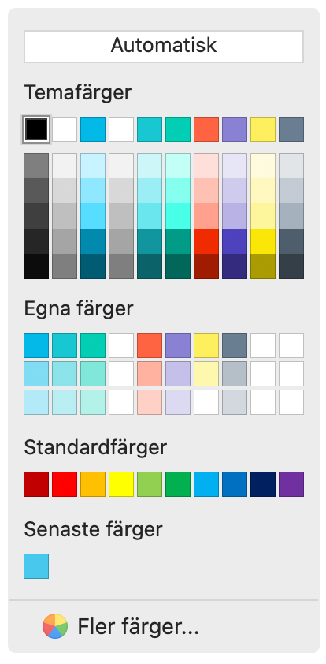
The LiU colours
100%
50%
30%
Base colours
Accent colours

Slide 5
Find out about the LiU graphic profile on Liunet
liuonline.sharepoint.com

